Slide 1



FINDING KEY INFORMATION
with the use of reading strategies

Slide 2



Welcome, readers!
Are you ready to be a better reader and learn a bit about history?

Slide 3



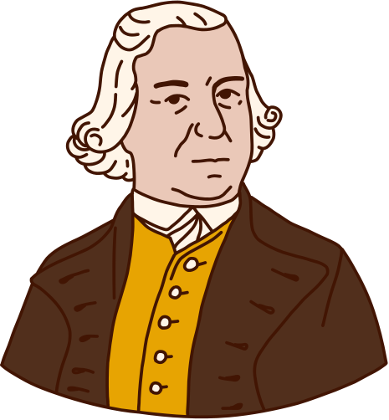

In this lesson:
YOU WILL
LEARN TO:
YOU WILL ALSO
LEARN ABOUT:
Use reading strategies to find key details and make inferences in informational texts
Some key historical events that led to the American Revolution

Slide 4

How do we find key information?
Explicit details: facts and other information direct from the source
Implicit details: details given indirectly and can be known by drawing inferences
We find them through reading strategies!
Drawing inferences: interpreting how details in the text relate to each other and how we can connect our own knowledge to the text

Slide 5





THREE READING STRATEGIES
3. HEAD
1. HERE
What you are asked to answer is not in the text, but you should write your opinion of what the passage suggests.
When you look for answers in the text, you can say “it’s here!” It involves looking for information that often answers five Ws questions.
2. HIDDEN
Looking for hidden information in what we are reading means considering context clues and connecting them to the question.

Slide 6





READING PASSAGE (PART 1 OF 2):
Taxation without Representation
In 1763, Charles Townshend was appointed First Lord of Trade and George Grenville was appointed Prime Minister. Townshend, a specialist in American politics, advocated maintaining a permanent army in America that would be financed by taxes imposed by the Parliament because he believed that the colonies should not be allowed to rule themselves.
The colonies had already contributed to the war by raising and supporting a large number of soldiers while increasing their debt in the process. In March 1764, Grenville proposed a plan in the House of Commons that mandated that a variety of papers and documents in America bear stamps signifying payment.

Slide 7


The “Here” strategy
EXCERPT:
In March 1764, Grenville proposed a plan in the House of Commons [...]
Some information you are asked of can be found RIGHT HERE in the text. It's literally there!
QUESTION:
When did Grenville proposed a plan mandating stamps in many papers in the American colony?
Grenville proposed this plan in March 1764.
ANSWER:

Slide 8

The “Hidden” strategy
EXCERPT:
In 1763, Charles Townshend was appointed First Lord of Trade and George Grenville was appointed Prime Minister. Townshend, a specialist in American politics, advocated maintaining a permanent army in America that would be financed by taxes imposed by the Parliament because he believed that the colonies should not be allowed to rule themselves.
The information you are asked for can't be found in a single spot, but you will find it by following clues in the text.
clues
QUESTION:
What led to the House of Commons imposing taxes on the American colony?
How will you write this answer?

Slide 9
QUESTION:
EXCERPT:
What led to the House of Commons imposing taxes on the American colony?
In 1763, Charles Townshend was appointed First Lord of Trade and George Grenville was appointed Prime Minister. Townshend, a specialist in American politics, advocated maintaining a permanent army in America that would be financed by taxes imposed by the Parliament because he believed that the colonies should not be allowed to rule themselves.
clues
SAMPLE ANSWER:
In 1763, Townshend and Grenville came into power. Grenville believed an army in America had to be financed by taxes decided by the Parliament as colonies should not rule themselves.

Slide 10

Do you remember the
5 Ws and 1 H?
WHO
WHEN
WHAT
WHY
WHERE
HOW
These are the question words we need while reading. They help us note, recall, and even write key information.
Ask a question about the reading passage using one of these words.

Slide 11
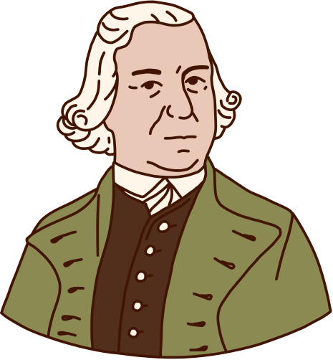
READING PASSAGE (PART 2 OF 2):
Taxation without Representation
A well-known Massachusetts leader named Samuel Adams authored a number of resolutions stating that Parliament had no authority to tax the colonies without giving them a voice.
Sending letters in support, other colonies emphasized that as free English citizens, they should not be taxed unless they had a voice in
the decision-making process (taxation without representation).
Parliament disregarded their requests and enacted the Stamp Act in 1765 despite their protests. The colonists had a strong reaction to this, which sparked widespread demonstrations against the new law.

Slide 12
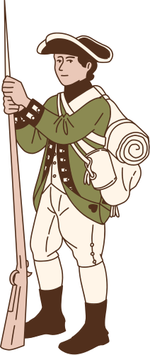
The “Head” strategy
EXCERPT:
Townshend, a specialist in American politics, advocated maintaining a permanent army in America that would be financed by taxes imposed by the Parliament because he believed that the colonies should not be allowed to rule themselves. (From Part 1)
What you are asked to answer is not in the text, but you should write your opinion of what the passage suggests.
QUESTION:
A well-known Massachusetts leader name﻿d Samuel Adams authored a number of resolutions stating that Parliament had no authority to tax the colonies without giving them a voice. (From Part 2)
Do you think that imposing taxes was a fair solution to help support the colonies?
Read the excerpts closely.

Slide 13
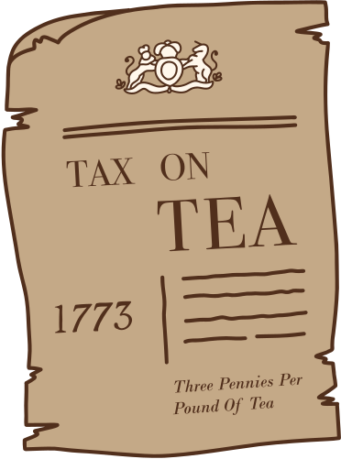
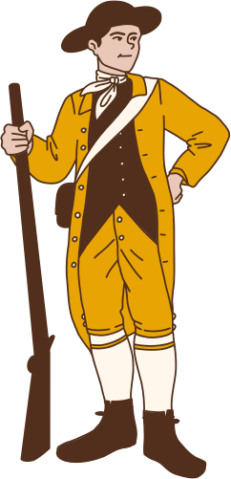
EXCERPT:
QUESTION:
Do you think that imposing taxes was a fair solution to help support the colonies?
Townshend, a specialist in American politics, advocated maintaining a permanent army in America that would be financed by taxes imposed by the Parliament because he believed that the colonies should not be allowed to rule themselves. (From Part 1)
SAMPLE ANSWER:
I don't think it was a fair solution to make them pay taxes because the American people did not have representatives in England to make their opinions heard.
A well-known Massachusetts leader name﻿d Samuel Adams authored a number of resolutions stating that Parliament had no authority to tax the colonies without giving them a voice. (From Part 2)

Slide 14


Try and Apply
It‘s time to read again and use
HERE, HIDDEN and HEAD!

Slide 15

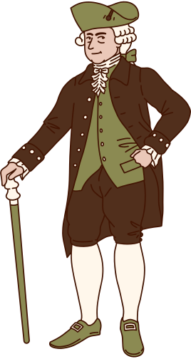
Read the passage again.
1
Who were the two men appointed to key positions in England in 1763?
2
What did Charles Townshend advocate regarding American politics and taxation?
Using the HERE strategy, what is your answer to these questions?

Slide 16
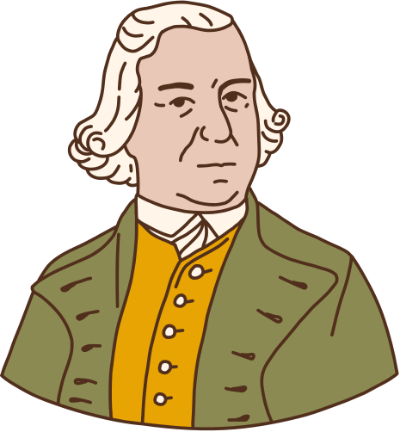


Read the passage again.
3
Why were the American colonists alarmed by Grenville's plan for stamped papers and documents?
4
What did the Massachusetts leader Samuel Adams believe about the authority of Parliament to tax the colonies?
Using the HIDDEN strategy, what is your answer to these questions?

Slide 17


Read the passage again.
5
Do you think the American colonists' protests against the Stamp Act were justified? Why or why not?
6
How do you think the passage demonstrates the tensions between the American colonists and the British Empire?
Using the HEAD strategy, what is your answer to these questions?

Slide 18

Sample Answers
1
Charles Townshend and George Grenville.
4
Samuel Adams believed that Parliament had no authority to tax the colonies without giving them a voice.
2
Charles Townshend advocated maintaining a permanent army in America financed by taxes imposed by the Parliament, as he believed that the colonies should not be allowed to rule themselves.
5
I think that their protests were justified because colonists believed in the principle of no taxation without representation and saw the Stamp Act as taking away their rights.
3
The American colonists were alarmed because they believed that the stamped papers signifying payment were seen as a form of taxation imposed on them without their consent.
The colonists believed they should have a voice in decisions that affected them, while the British Parliament did not care about their requests and enacted the Stamp Act despite protests.
6

Slide 19

Reference
Add your references here.

Slide 20
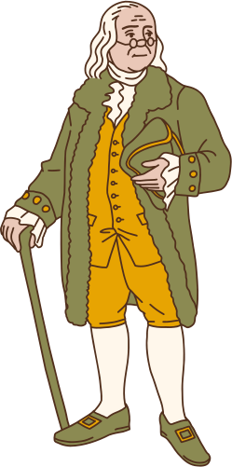
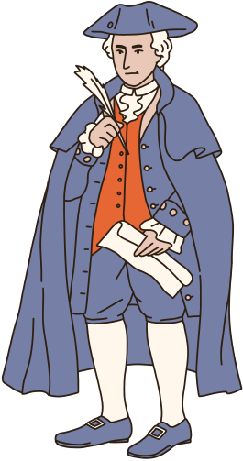
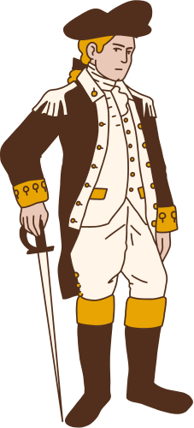


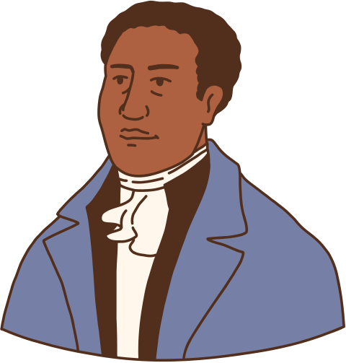
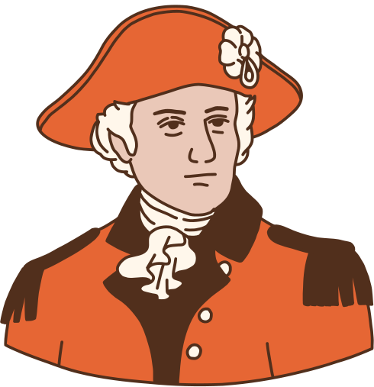
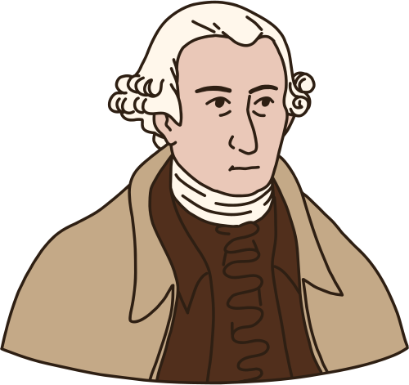


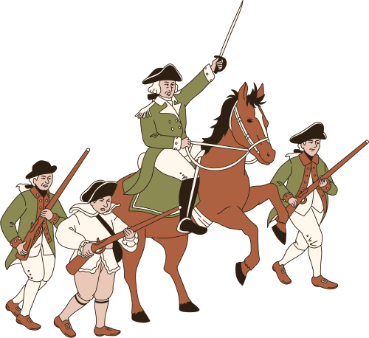



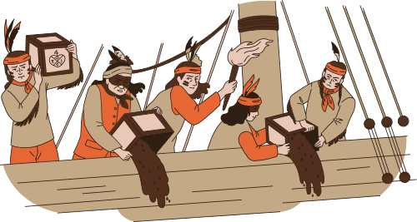
Resource Page
Use these icons and illustrations in your Canva Presentation. Use the codes below to search for more images in the Elements tab. Happy designing! Don't forget to delete this page before presenting.
SET:NAFTJUCXA3C
SET:NAE1GGEU6AS

Slide 21
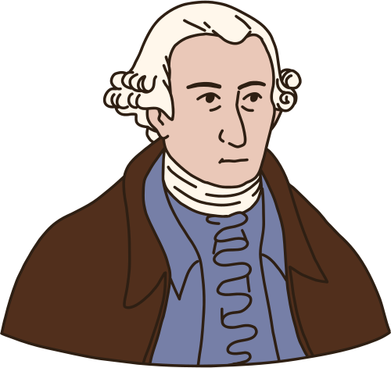

Try this background for online class.
*PLEASE DELETE THIS SECTION BEFORE DOWNLOADING.

Slide 22
Press these keys
while on Present mode!
B for blur | C for confetti
D for a drumroll | M for mic drop
O for bubbles | Q for quiet
U for unveil | Any number from 0-9 for a timer

